Slide 1
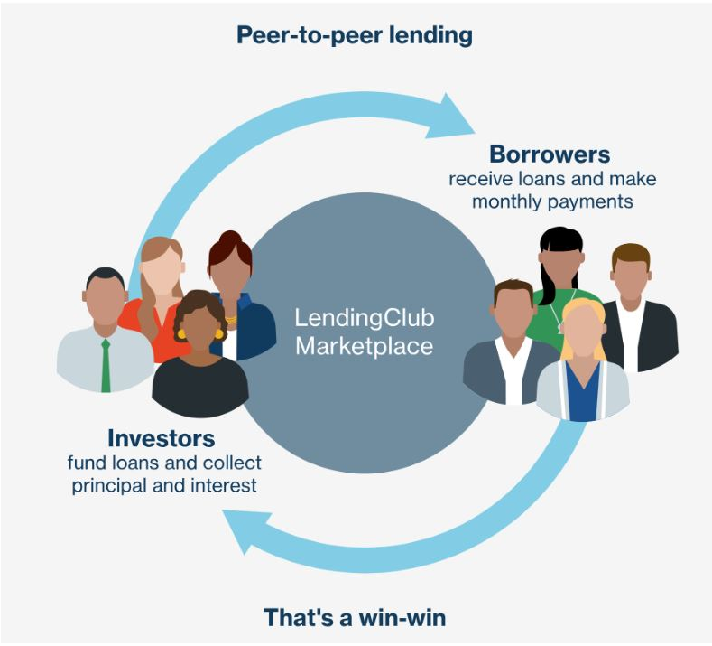
Lending Club Loan Prediction
By
Nilesh Nerkar

Slide 2
Introduction
Lending Club is a US peer-to-peer lending company.
The company claims that $15.98 billion in loans had been originated through its platform up to December 31, 2015.
Lending Club enables borrowers to create unsecured personal loans between $1,000 and $40,000.
The standard loan period is three years. Investors can search and browse the loan listings on Lending Club website and select loans that they want to invest in based on the information supplied about the borrower, amount of loan, loan grade, and loan purpose.
Investors make money from interest. Lending Club makes money by charging borrowers an origination fee and investors a service fee

Slide 3
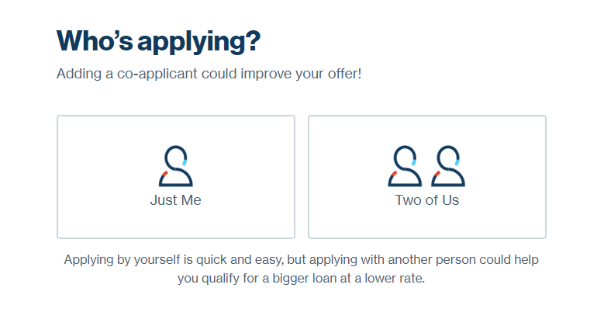
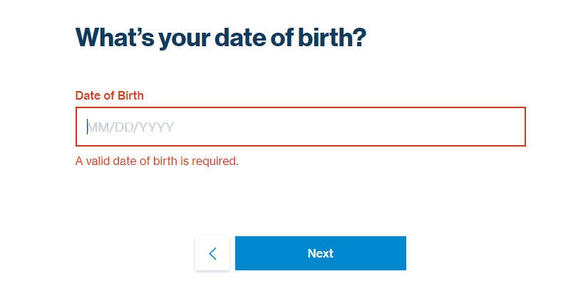
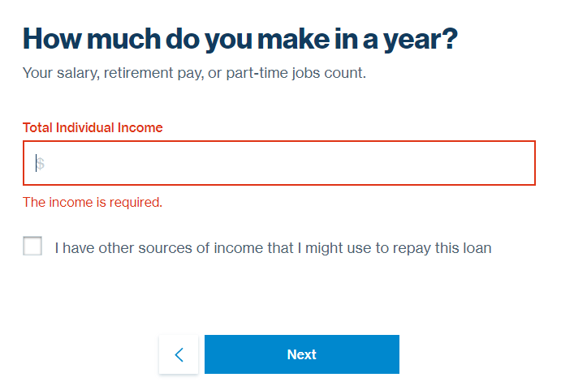
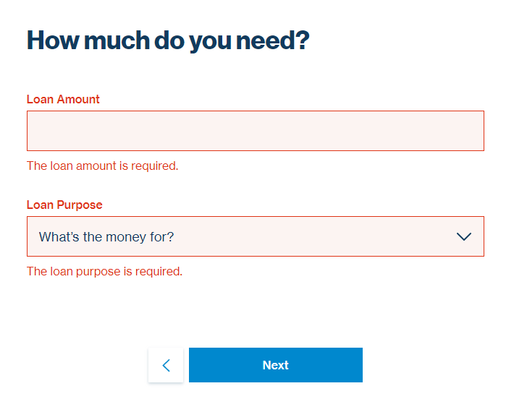
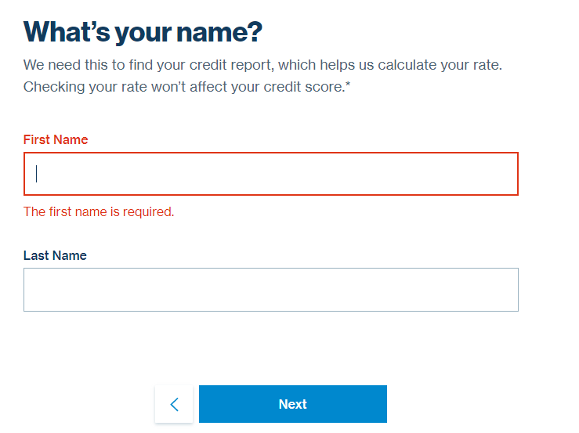
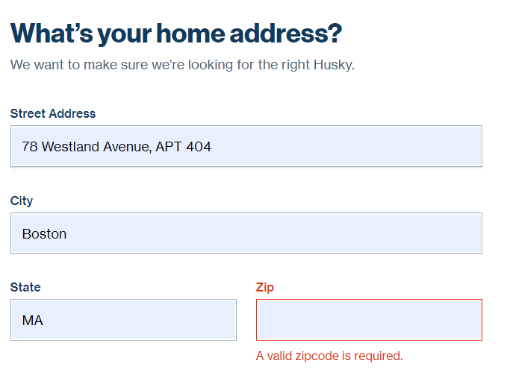
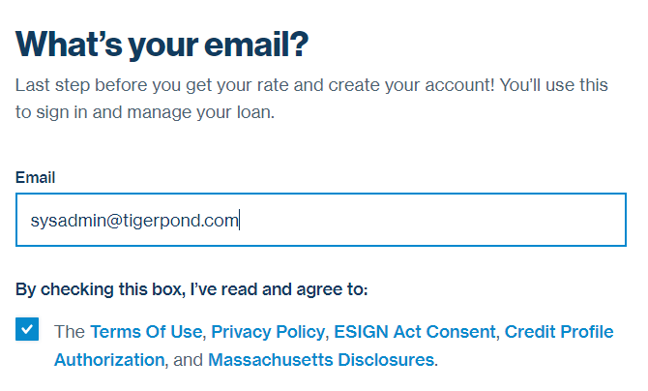
Lending Club- Check my rate

Slide 4
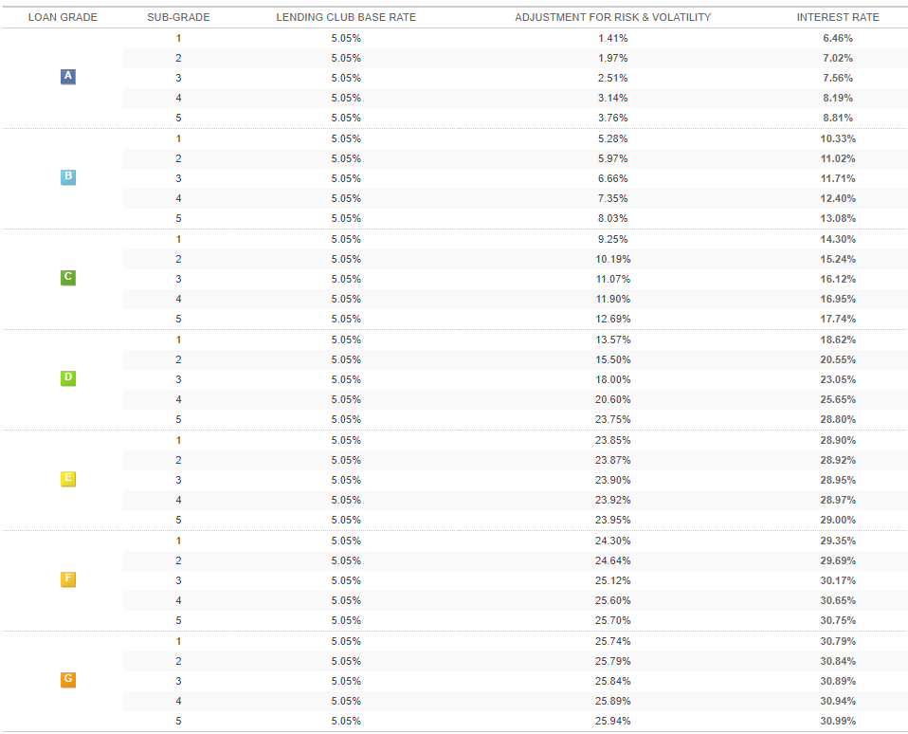

Slide 5
Approach
1. Exploratory Data Analysis
2. Data Cleaning
3. Feature Selection
4. Modelling

Slide 6
Exploratory Data Analysis
Data Preprocessing: Read the data from the CSV file that has 2260668 rows and 145 features.
Filter the features based on missing values.
Removing any values that exceeded 50% of missing values.
Handling the missing values with imputer

Slide 7
Pre-Processing Data
Cleaned the missing values
Dropped features related to Current Loans
Categorical Features Handling
Label Encoding
Continuous Feature

Slide 8
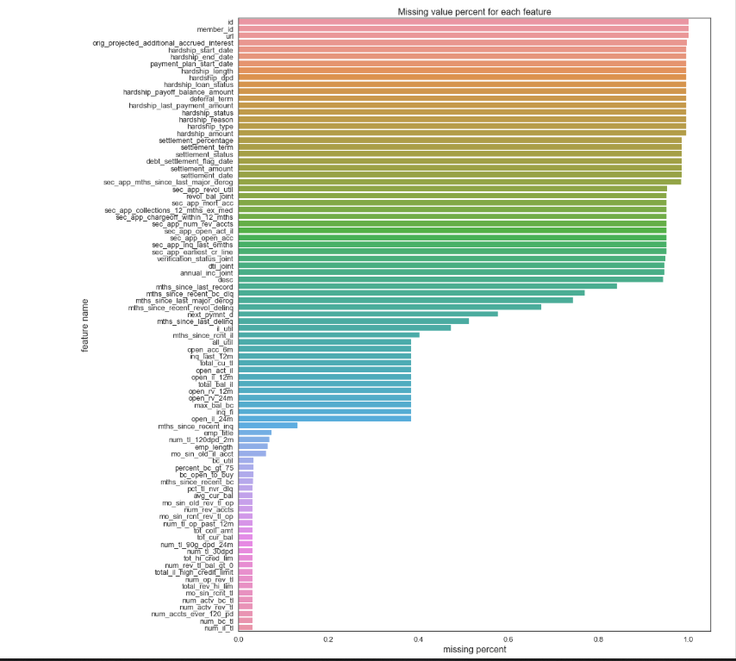
Bar Graph of missing values
As we can see there are several features that can be depicted in the bar graph.

Slide 9
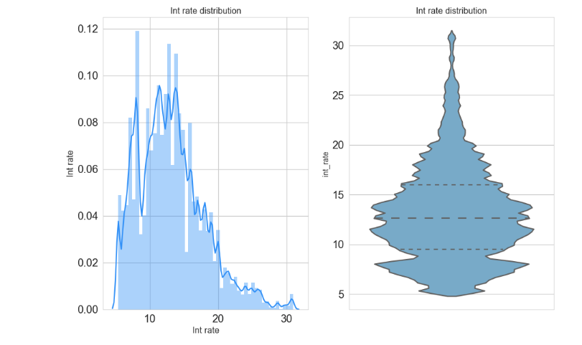

Slide 10
EDA from Notebook

Slide 11
Feature Selection
Following are the techniques used for Feature Selection:
Correlation between Features
Backward Elimination (OLS model)
Feature Elimination(Recursive Feature Elimination)
Sequential Feature Selection (Forward)
BorutaPy Algorithm

Slide 12
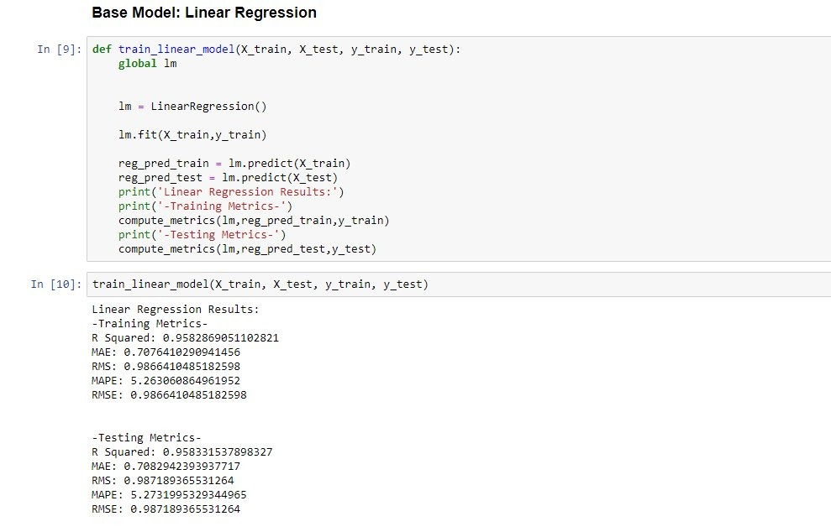
Prediction of Interest Rate
Linear Regression-Base Model

Slide 13
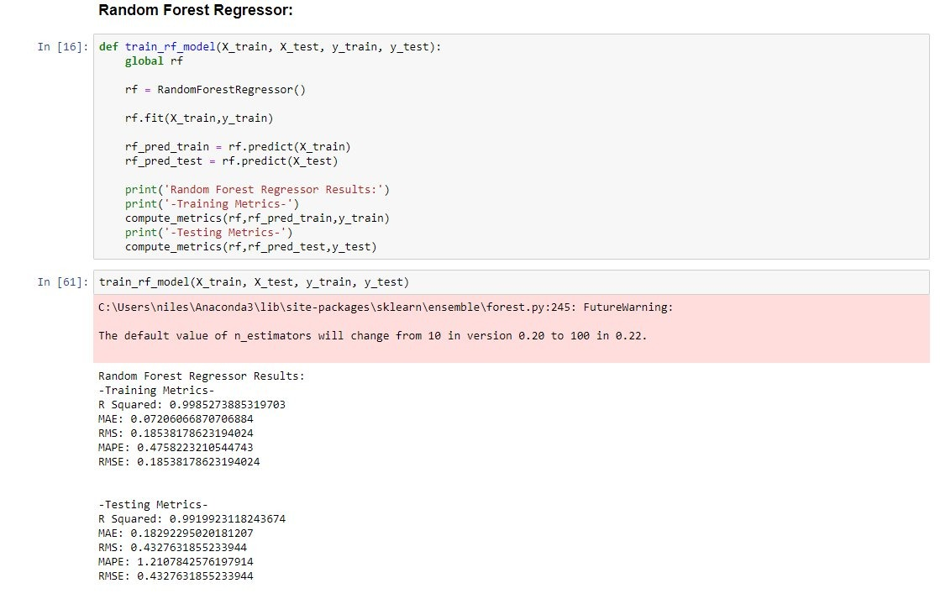
Random Forest Prediction metrices

Slide 14
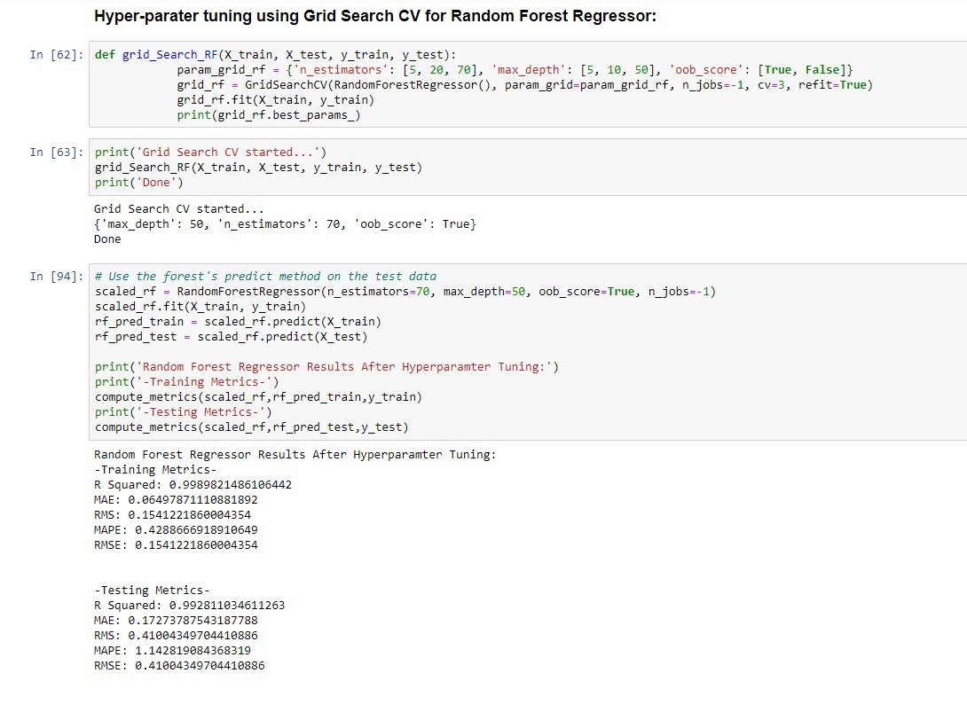
Hyper Parameter tuning Random Forest

Slide 15
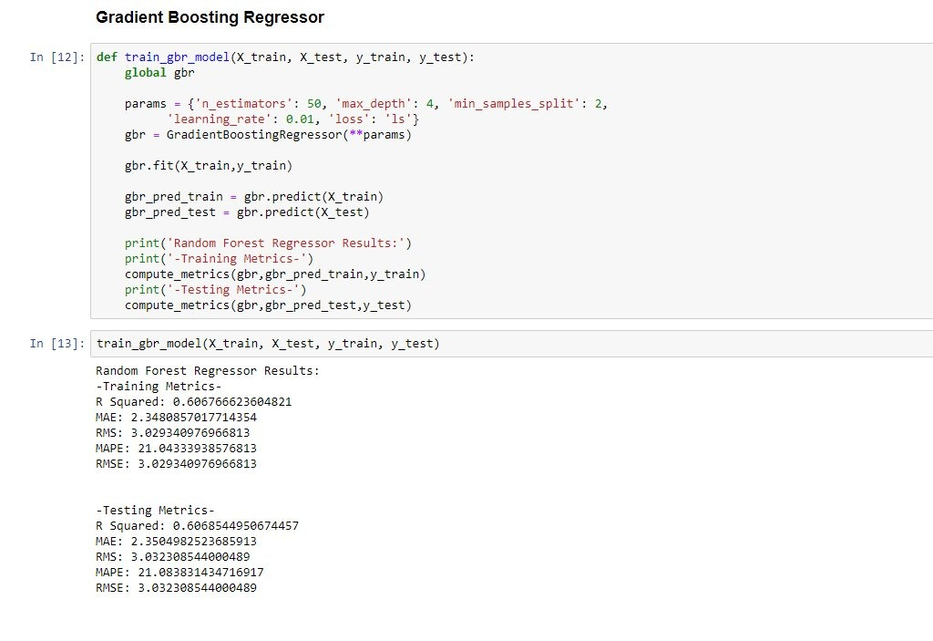
Gradient Boost Regressor

Slide 16
Model Selection
Regression: Random Forest (Hyper parameter Tuning)

Slide 17
Thank you

